Slide 1
QoE Inference and Improvement Without End-Host Control
Ashkan Nikravesh¹, Qi Alfred Chen², Scott Haseley³, Xiao Zhu¹, Geoffrey Challen³, Z. Morley Mao¹
¹ University of Michigan, ² UC Irvine, ³ UIUC

Slide 2






QoS does not always translate to QoE
Network edge
ISP
Quality of Experience
video bitrate
rebuffer delay
ISP
Quality of Experience
launch time
response time
Quality of Service
bandwidth, delay, loss

Slide 3
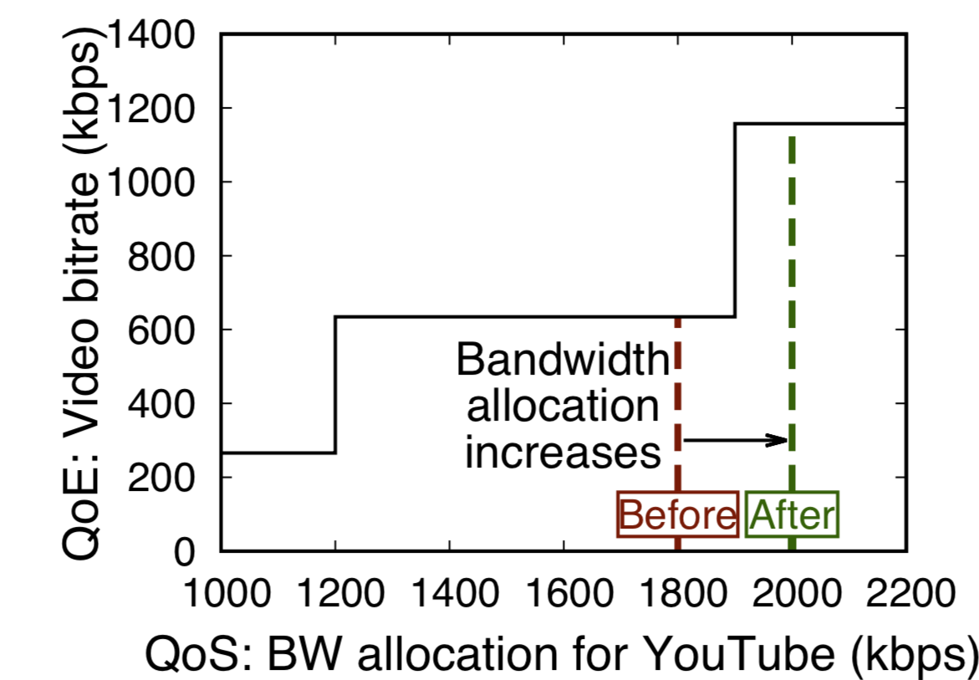
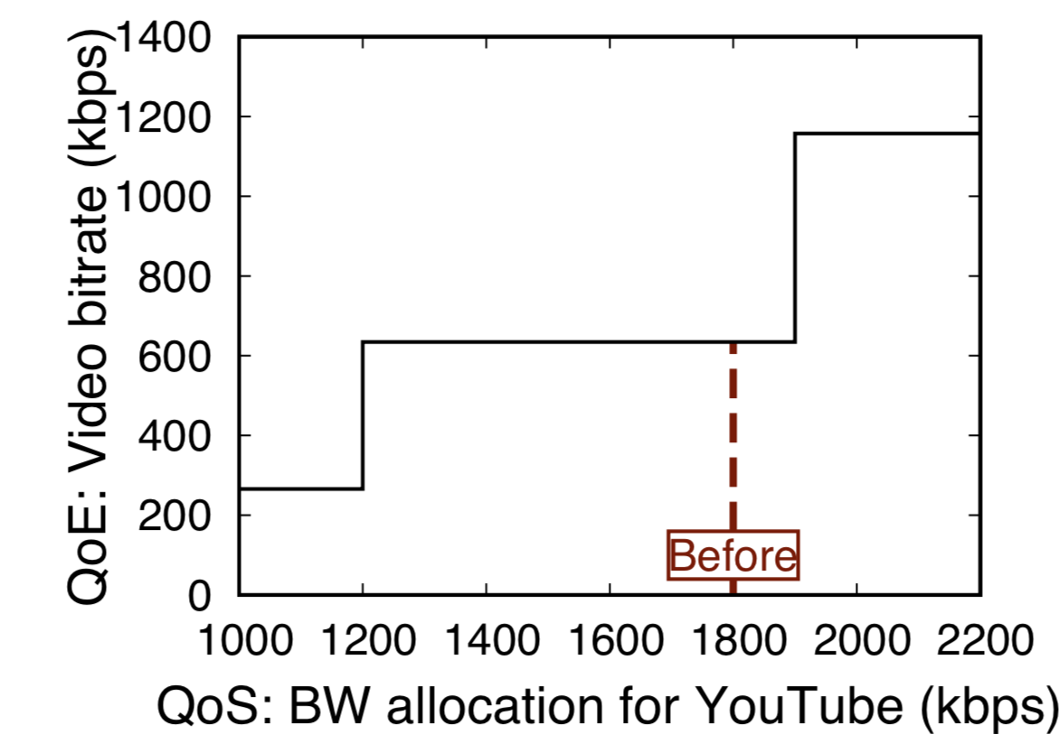
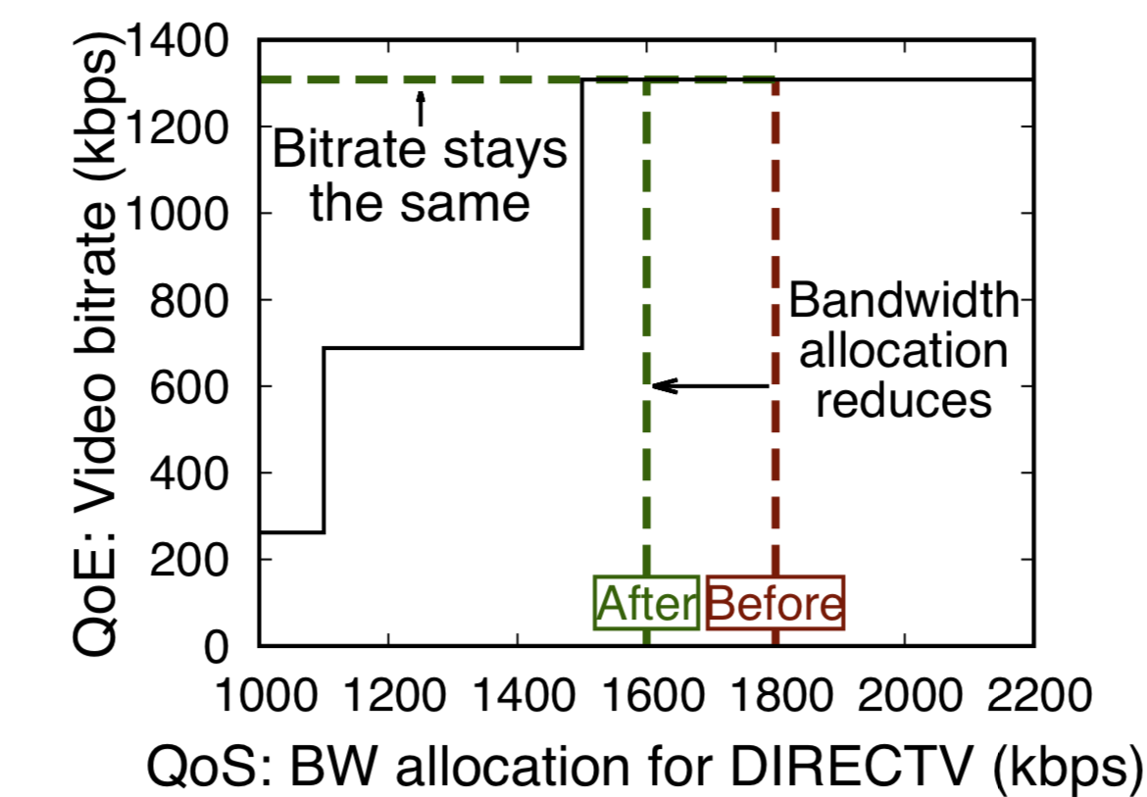
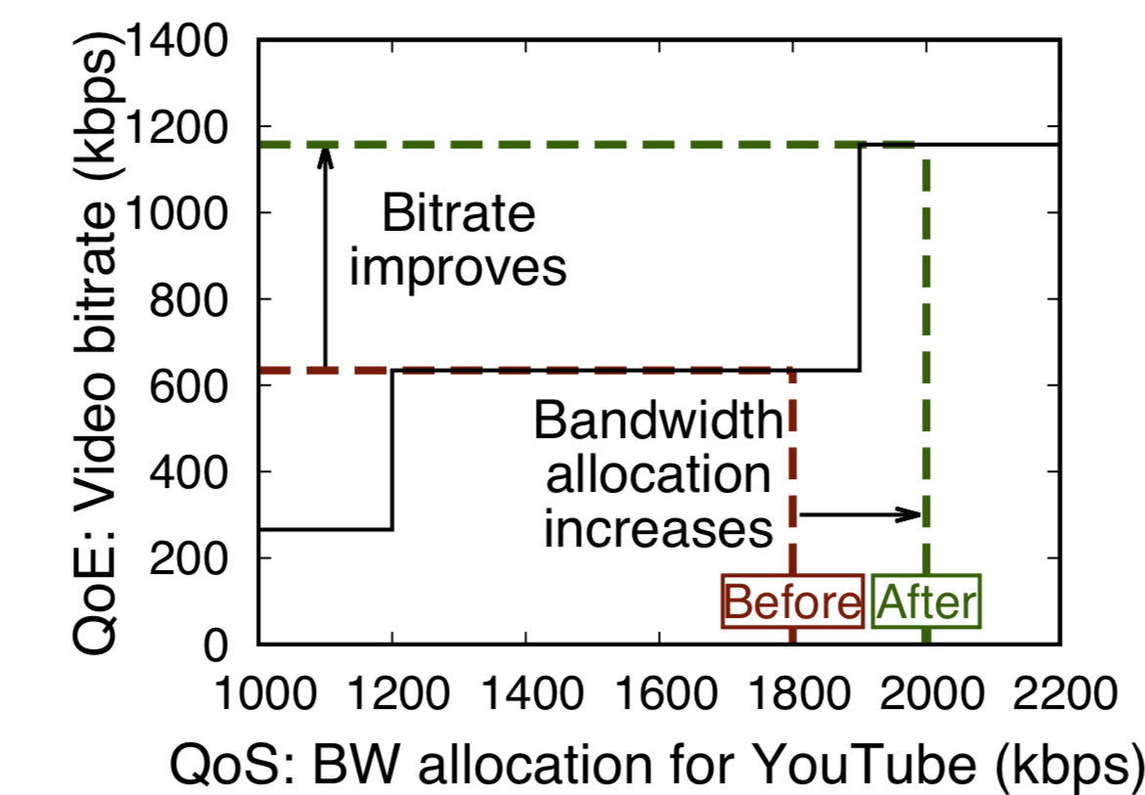
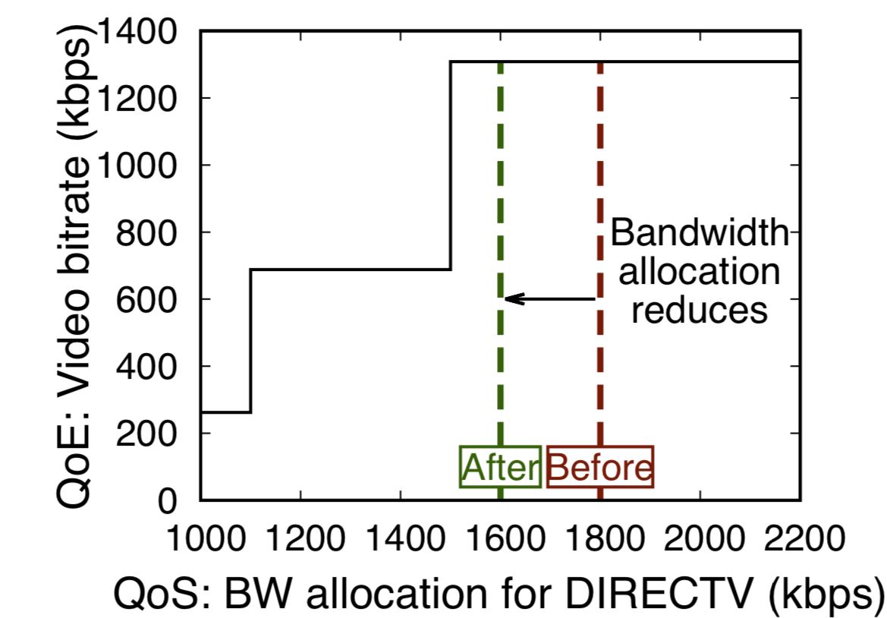
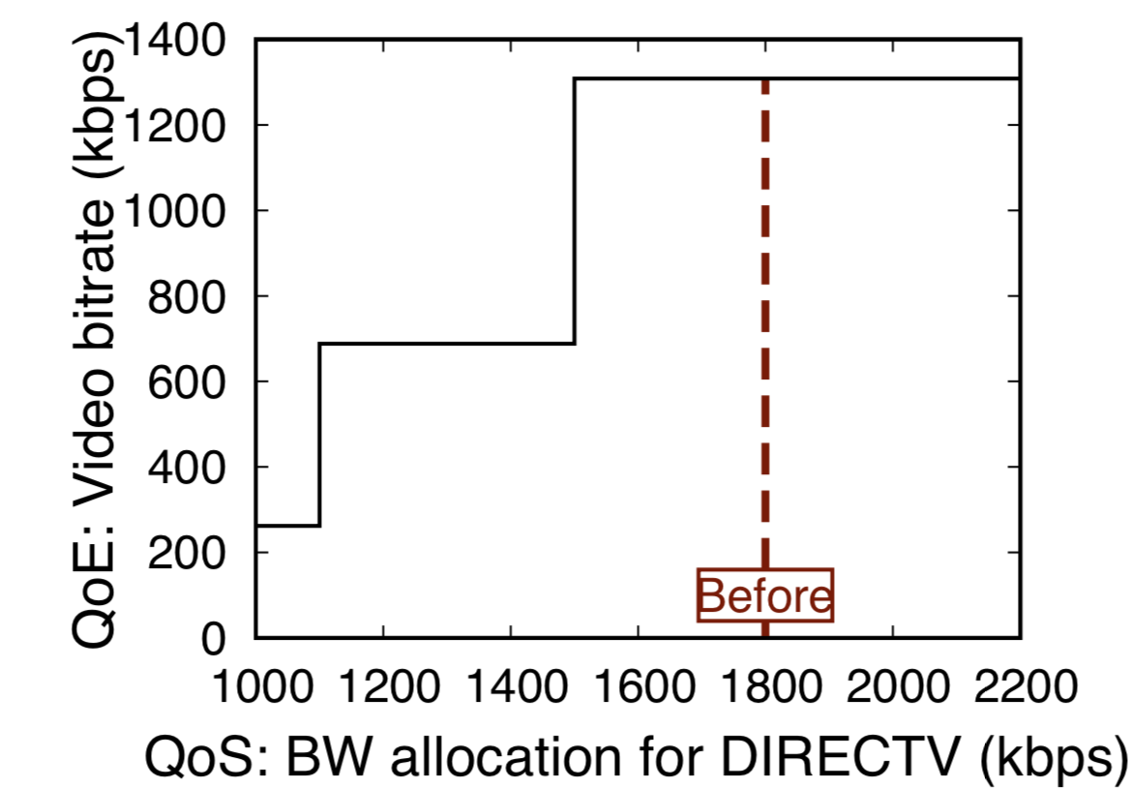
Can the network edge allocate bandwidth in a way to improve overall QoE?
Alice is watching DIRECTV (left), Bob is watching YouTube (right)
The total available bandwidth (BW) is 3600kbps
QoE-aware BW allocation at the edge improves the overall QoE.

Slide 4
QoE measurement is challenging

Slide 5
Proposed approach to QoE inference
Offline generation of per-application QoS-to-QoE mappings
Replay of real users’ common interactions (usages) in popular apps
Adaptive sampling of the QoS metric space
…
…

Slide 6
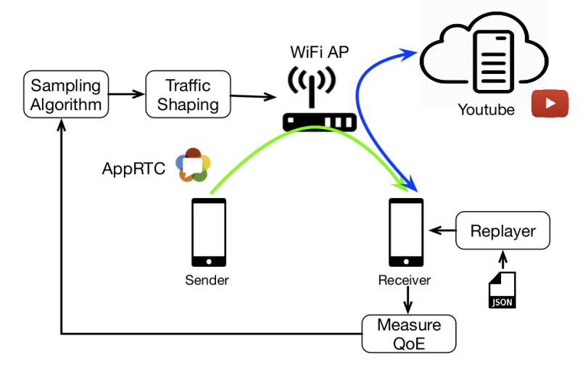
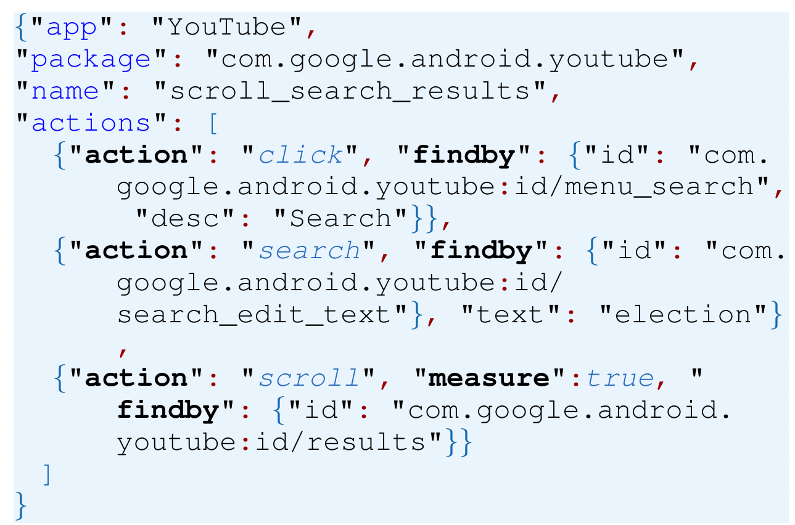
QoS-to-QoE mapping
App communicates with its own server
Emulating different network settings
Running multiple clients for collaborative apps

Slide 7
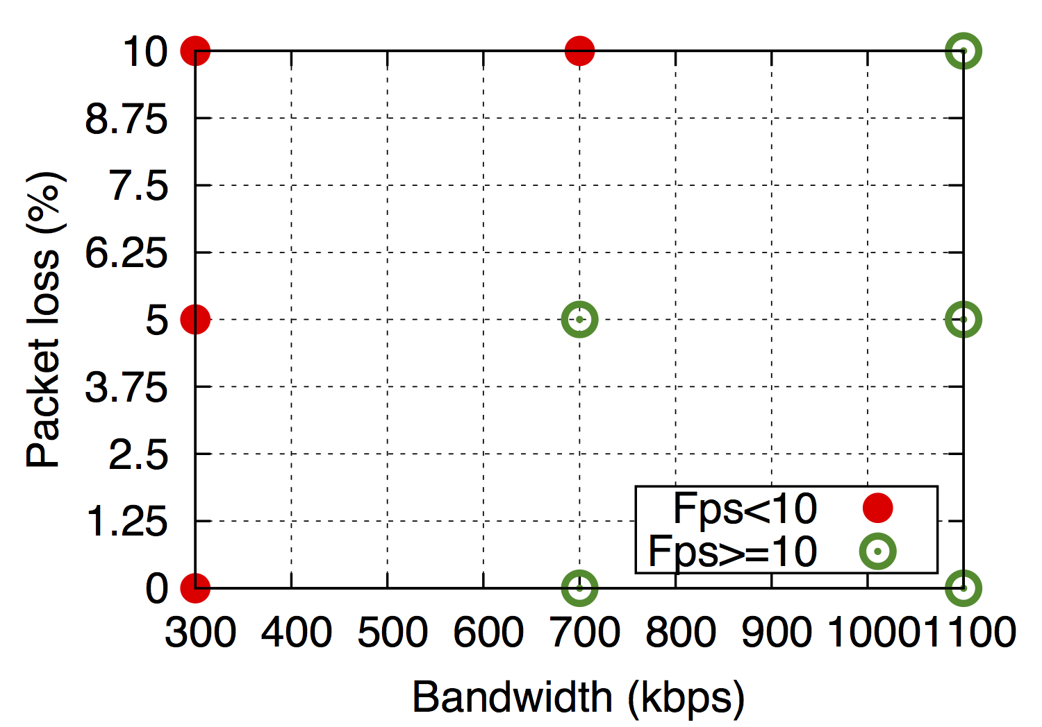
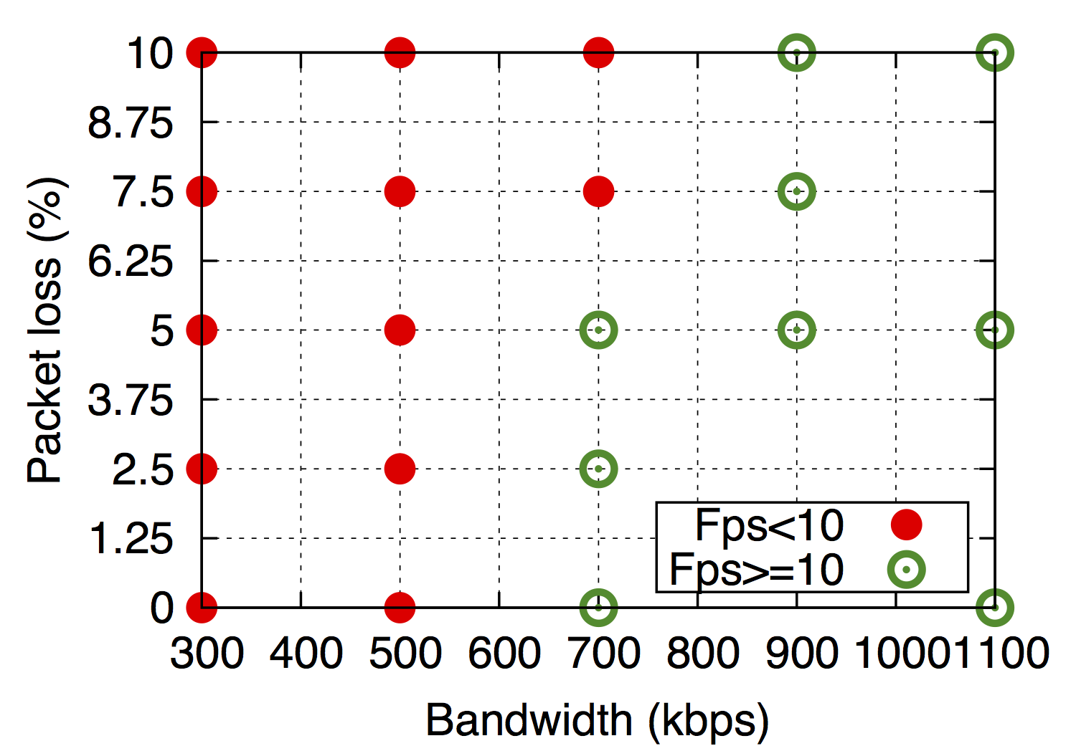
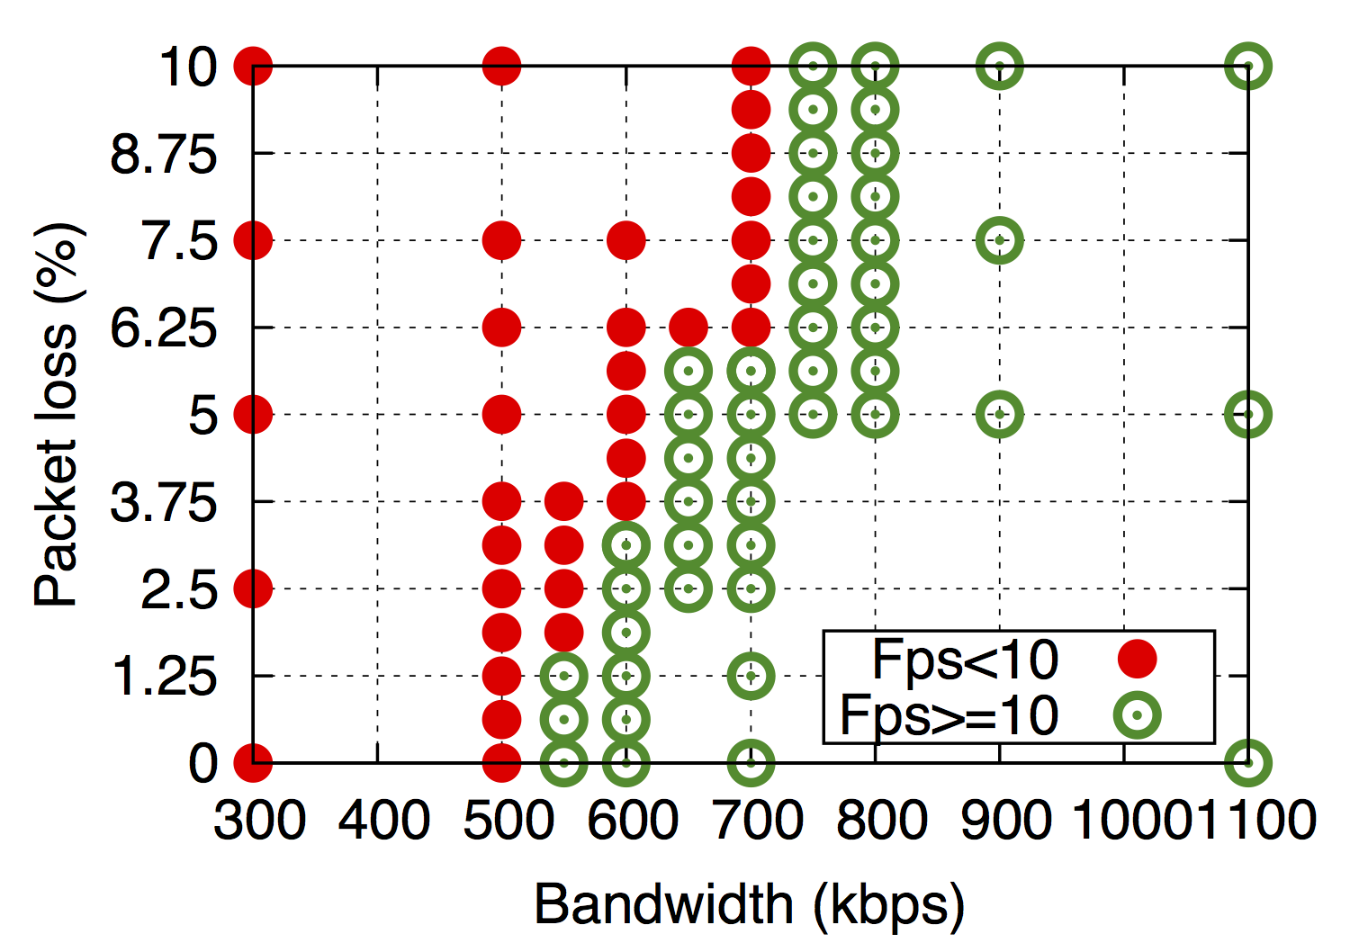
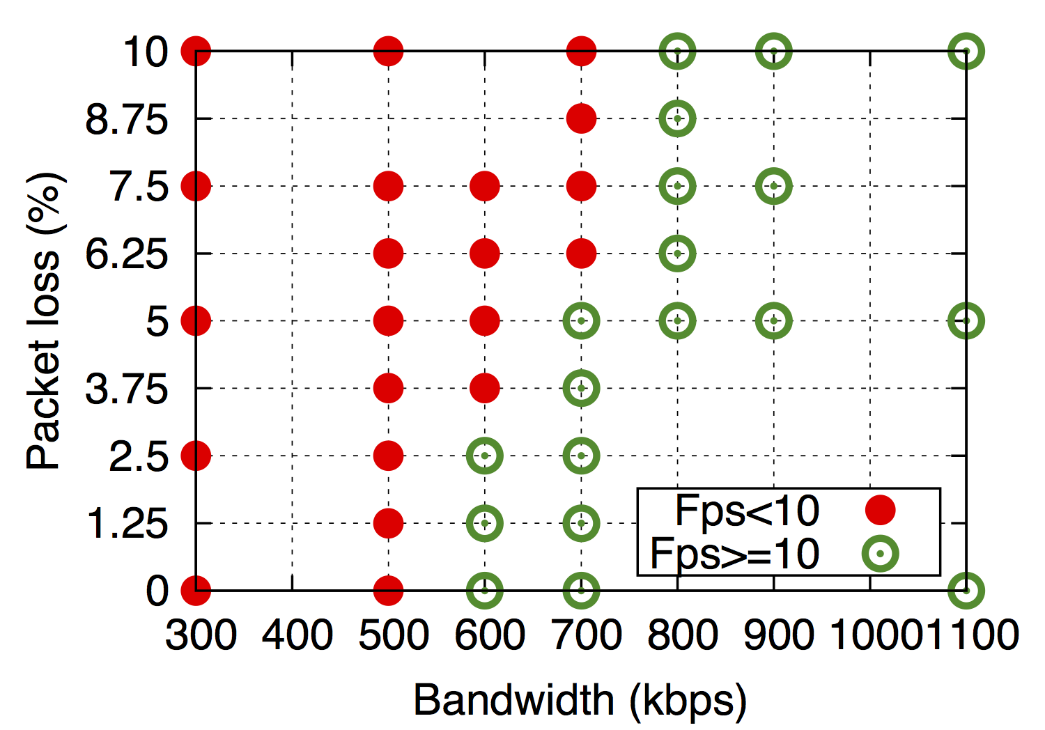
Challenge: Large QoS metric space
Solution: adaptive sampling
e.g., map QoS (bandwidth, packet loss) to QoE (frame per second)
Different QoE Continue!
Different QoE
Continue!
Same QoE
Stop search
Different QoE Continue!
Continue search
Adaptive sampling helps identify the boundary between different classes of QoE with much fewer QoS samples.

Slide 8
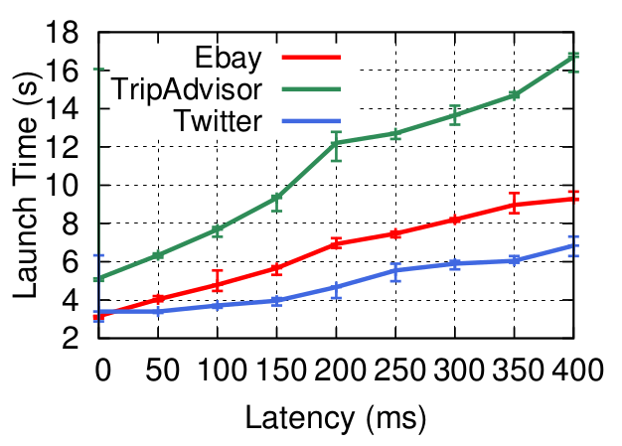
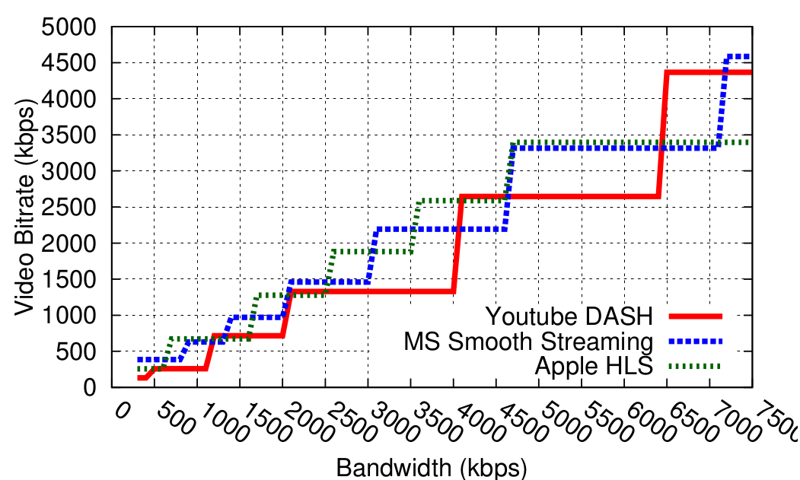
Example QoS-QoE mappings
Interactive apps (left)
Video streaming apps (right)
1. Different apps can have very different QoS-QoE mapping. 2. Significant non-linearities exist for video streaming.

Slide 9
Can we utilize per-app QoS-to-QoE models?

Slide 10
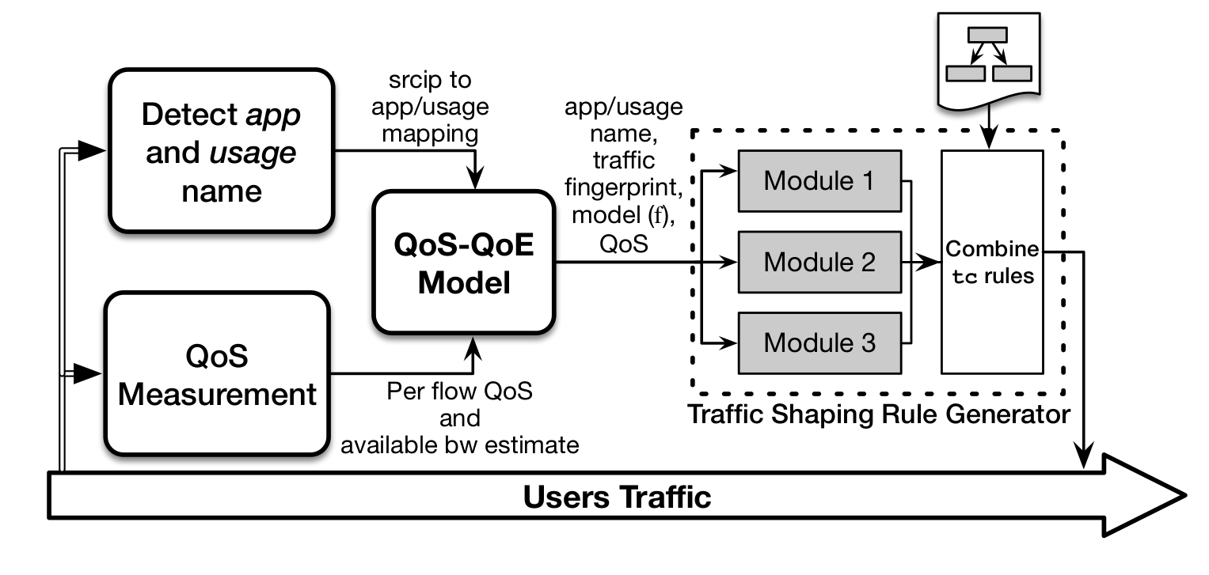
QoEBox: Improving QoE at the network edge without end-host control

Slide 11
Case Study I: Classifying and prioritizing different traffic types
QoEBox classifies flows into three classes
Latency sensitive traffic: e.g., click and scroll in interactive apps
Bandwidth and latency sensitive traffic: e.g., video conferencing
Bandwidth intensive traffic: e.g., video streaming, file download

Slide 12
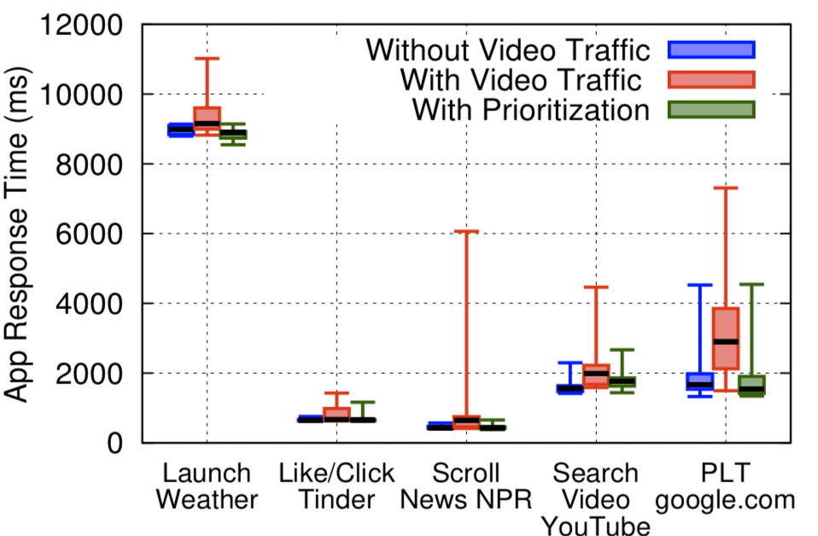
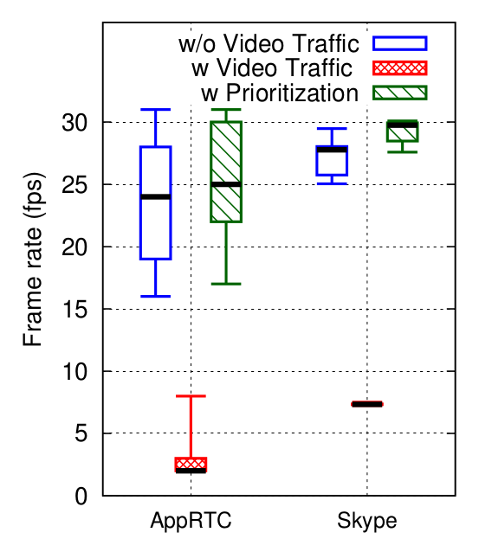
Classifying and prioritizing different traffic types
1. Response time and frame rate degrades with concurrent video traffic. 2. Prioritization helps improve them by 46% and 115%, respectively.

Slide 13
Case Study II: QoE-aware bandwidth allocation
Key lesson: A change to QoS does not necessarily lead to a change in video streaming QoE
Optimization problem: Maximize total video bitrate under bandwidth constraints -- Optimal bitrate without fairness
Variant I: Ensure fairness
Users of the same app receive equal bandwidth -- Optimal bitrate with fairness
Variant II: Reduce disparity
Bandwidth of different users shouldn’t vary too much -- Equal bandwidth with optimization

Slide 14
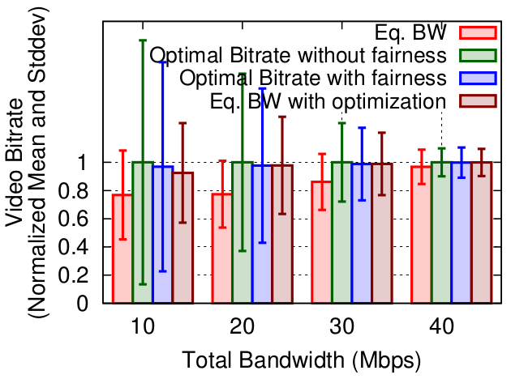
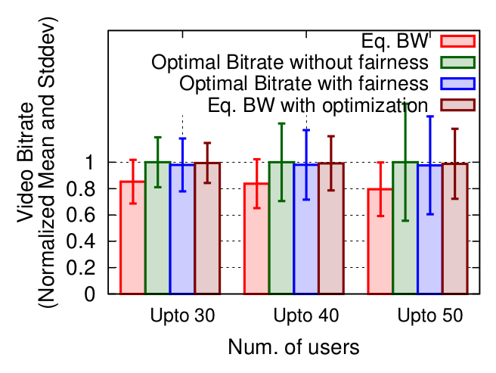
QoE-aware bandwidth allocation
Small scale experimentation (left)
Large scale simulation (right)
All our algorithm variants improve the average video bitrate, the improvement can be up to 23%.

Slide 15
Conclusion
Offline generation of per-app QoS-QoE models
A QoE-based traffic management framework at the edge: QoEBox
Real-world case studies
Traffic classification and prioritization
QoE-aware bandwidth allocation

Slide 16
Thank you!

